Slide 1
Tutorial 2 CS335A
Packet Switching vs Circuit Switching Delays, Throughput, Loss

Slide 2

Circuit Switching
end-to-end resources allocated to, reserved for “call” between source and destination
in diagram, each link has four circuits.
call gets 2nd circuit in top link and 1st circuit in right link.
dedicated resources: no sharing
circuit-like (guaranteed) performance
circuit segment idle if not used by call (no sharing)
commonly used in traditional telephone networks
* Check out the online interactive exercises for more examples: http://gaia.cs.umass.edu/kurose_ross/interactive
Notes:
Η μεταγωγή κυκλώματος (circuit switching) είναι μια μέθοδος επικοινωνίας που χρησιμοποιείται κυρίως στα τηλεφωνικά δίκτυα,
όπου για να πραγματοποιηθεί μια σύνδεση μεταξύ δύο χρηστών, δεσμεύεται ένα αποκλειστικό “μονοπάτι” (κύκλωμα) στο δίκτυο για όλη τη διάρκεια της επικοινωνίας.
1. Το δίκτυο δημιουργεί ένα σταθερό κανάλι σύνδεσης ανάμεσα σε εσένα και τον συνομιλητή σου.
2. Καθ’ όλη τη διάρκεια της κλήσης, το κύκλωμα παραμένει δεσμευμένο — κανείς άλλος δεν μπορεί να το χρησιμοποιήσει.
3. Μόλις τελειώσει η κλήση, το κύκλωμα απελευθερώνεται.

Slide 3

Packet Switching
host sending function:
takes application message
breaks into smaller chunks, known as packets, of length L bits
network forwards packets from one router to the next, across links on path from source to destination
two packets,
L bits each
2
1
host
Notes:
Το αρχικό μήνυμα (π.χ. ένα email, ένα βίντεο ή μια ιστοσελίδα) χωρίζεται σε μικρότερα κομμάτια: πακέτα.
Κάθε πακέτο αποστέλλεται ανεξάρτητα μέσα από το δίκτυο προς τον προορισμό του
Όταν όλα τα πακέτα φτάσουν στον προορισμό, επανασυνδέονται για να σχηματίσουν το αρχικό μήνυμα
4. Το Internet βασίζεται εξ ολοκλήρου στη μεταγωγή πακέτου.
Η μεταγωγή πακέτου (packet switching) είναι ένας τρόπος μετάδοσης δεδομένων σε δίκτυα (όπως το Internet),
όπου οι πληροφορίες χωρίζονται σε μικρά πακέτα, και κάθε πακέτο αποστέλλεται ανεξάρτητα μέσα από το δίκτυο προς τον προορισμό του.
Όταν όλα τα πακέτα φτάσουν στον προορισμό, επανασυνδέονται για να σχηματίσουν το αρχικό μήνυμα.
Bandwidth is the maximum rate at which data can be transmitted over a network connection or communication channel, usually measured in bits per second (bps).
👉 In simple terms, it’s like the width of a pipe — the wider the pipe (higher bandwidth), the more data can flow through at once.

Slide 4
Packet switching versus Circuit switching
Packet Switching
resources are reserved on demand
great for “bursty” data
sometimes has data to send, but at other times not
resource sharing
simpler, no call setup
excessive congestion possible:
packet delay and loss due to buffer overflow
protocols needed for reliable data transfer, congestion control
Circuit Switching
resources are allocated end-to-end
reserved even during idle times
no sharing
call setup to allocate resources
bandwidth guarantees

Slide 5
Host: sends packets of data
bandwidth: the maximum rate at which data can be transmitted over a network connection (R)
how fast data can be placed into the physical link i.e. the cable
link transmission rate, link capacity, link bandwidth
measured in bits per second (bps)
not bytes be careful in assignment
two packets,
L bits each
2
1
host
R: link transmission rate (bandwidth)
Notes:
Τι είναι: ο ρυθμός με τον οποίο τα bits μπορούν να “μπουν” στο link — όχι πόσο γρήγορα ταξιδεύουν μέσα στο καλώδιο
Παράδειγμα: Ένα link με 20 bps σημαίνει ότι το πολύ 20 bits μπορούν να σταλούν κάθε δευτερόλεπτο.
Οπτική ιδέα: Τα bits “μπαίνουν” στο link σαν σταγόνες σε έναν σωλήνα με ρυθμό 20 bits/sec.
Το bandwidth είναι το “πόσο μεγάλο είναι o σωλήνας”.
Το packet transmission delay είναι ο “χρόνος που χρειάζεται για να περάσει το πακέτο μέσα από αυτόν τον σωλήνα”.

Slide 6



Packet-switching: store-and-forward
L bits
per packet
source
3
2
1
destination
R bps bandwidth/transmission rate
R bps
packet transmission delay: takes L/R seconds to transmit (push out) L-bit packet into link at R bps
packet
transmission
delay
time needed to
transmit L-bit
packet into link
L (bits)
R (bits/sec)
=
=
store and forward: entire packet must arrive at router before it can be transmitted on next link

Slide 7
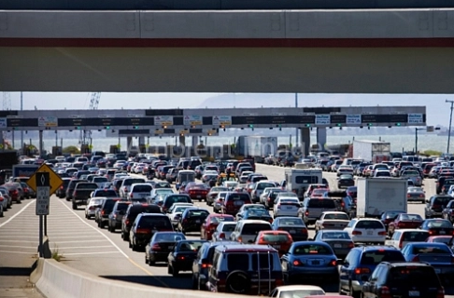

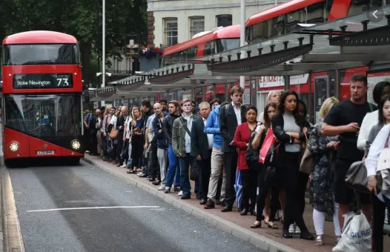
Packet-switching: queueing
R = 100 Mb/s
C
A
R = 1.5 Mb/s
D
B
E
queue of packets
waiting for transmission over output link
Queueing occurs when work arrives faster than it can be serviced:

Slide 8
Packet-switching: queueing
R = 100 Mb/s
C
A
R = 1.5 Mb/s
D
B
E
queue of packets
waiting for transmission over output link
Packet queuing and loss: if arrival rate (in bps) to link exceeds transmission rate (bps) of link for some period of time:
packets will queue, waiting to be transmitted on output link
packets can be dropped (lost) if memory (buffer) in router fills up

Slide 9
Packet delay: four sources
transmission
A
propagation
B
nodal
processing
queueing
d_{nodal} = d_{proc} + d_{queue} + d_{trans} + d_{prop}
d_{proc}: nodal processing
check bit errors
determine output link
typically < microsecs
d_{queue}: queueing delay
time waiting at output link for transmission
depends on congestion level of router

Slide 10
Packet delay: four sources
transmission
A
propagation
B
nodal
processing
queueing
d_{nodal} = d_{proc} + d_{queue} + d_{trans} + d_{prop}
d_{trans}: transmission delay:
L: packet length (bits)
R: link transmission rate (bps)
d_{trans} = L/R
d_{prop}: propagation delay:
d: length of physical link
s: propagation speed (~2x10⁸ m/sec)
d_{prop} = d/s
d_{trans} and d_{prop}
very different

Slide 11
Transmission vs Propagation Delay
Transmission Delay
time to push all bits of a packet into the link (from router)
depends on packet size and link bandwidth
d_{trans} = L/R
Propagation Delay
time for the signal to travel across the medium (cable, air etc.)
depends on distance and signal speed
d_{prop} = d/s
Key Difference
transmission = how fast data is put on the wire
propagation = how fast data moves through the wire

Slide 12
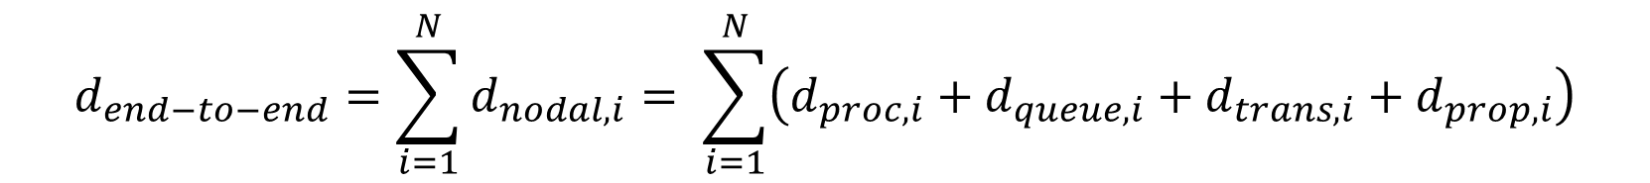
End to End Delay
The end-to-end delay is the sum of all the nodal delays
$$d_{end−to−end}=\sum_{i=1}^{N}{d_{nodal,i}= \sum_{i=1}^{N}{\left(d_{proc,i}+d_{queue,i}{+ d}_{trans,i}+ d_{prop,i}\right)}}$$
Where N = number of routers + the source host
host A (node 1)
router 1
(node 2)
router 2 (node 3)
host B

Slide 13
End to End Delay
Packet size: L = 1000 bits
Link 1: R₁ = 1 Mbps, d₁ = 100 km
Link 2: R₂ = 500 kbps, d₂ = 200 km
Link 3: R₃ = 2 Mbps, d₃ = 50 km
Propagation speed: s = 2 * 10⁸ m/s
Processing delay at each router: 1 ms
Queuing delay at each router: 2 ms
Problem: Host A sends a packet of 1,000 bits to host B.
Find the end-to-end delay.
transmission rate = 1 Mpbs link length = 100 km
transmission rate = 500 kpbs link length = 200 km
transmission rate = 2 Mpbs link length = 50 km
host A (node 1)
router 1
(node 2)
router 2 (node 3)
host B

Slide 14
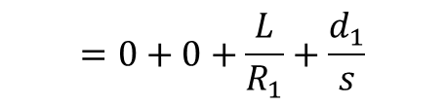
End to End Delay
Propagation speed: s = 2 * 10⁸ m/s
Processing delay at each router = 1 ms
Queuing delay at each router = 2 ms
For node 1:
$$=0+0+\frac{L}{R_{1}}+\frac{d_{1}}{s}$$
$$d_{nodal,1}{= d}_{proc,1}+ d_{queue,1}{+ d}_{trans,1}+ d_{prop,1 }$$
$$=\frac{1000}{1∙{10}^{6}}+\frac{100∙1000}{2∙{10}^{8}}=0.001+0.0005=0.0015 s=1,5 ms$$
transmission rate = 1 Mpbs link length = 100 km
transmission rate = 500 kpbs link length = 200 km
transmission rate = 2 Mpbs link length = 50 km
host A (node 1)
router 1
(node 2)
router 2 (node 3)
host B

Slide 15
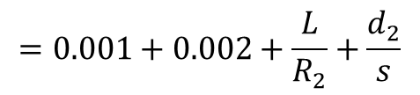
End to End Delay
Propagation speed: s = 2 * 10⁸ m/s
Processing delay at each router = 1 ms
Queuing delay at each router = 2 ms
For node 2:
$$=0.001+0.002+\frac{L}{R_{2}}+\frac{d_{2}}{s}$$
$$d_{nodal,2}{= d}_{proc,2}+ d_{queue,2}{+ d}_{trans,2}+ d_{prop,2 }$$
$$=0.003+ \frac{1000}{500∙1000}+\frac{200∙1000}{2∙{10}^{8}}=0.003+0.002+0.001=0.006 s=6 ms$$
transmission rate = 1 Mpbs link length = 100 km
transmission rate = 500 kpbs link length = 200 km
transmission rate = 2 Mpbs link length = 50 km
host A (node 1)
router 1
(node 2)
router 2 (node 3)
host B

Slide 16
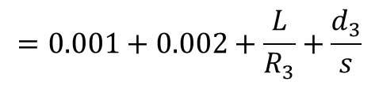
End to End Delay
Propagation speed: s = 2 * 10⁸ m/s
Processing delay at each router = 1 ms
Queuing delay at each router = 2 ms
For node 3:
$$=0.001+0.002+\frac{L}{R_{3}}+\frac{d_{3}}{s}$$
$$d_{nodal,3}{= d}_{proc,3}+ d_{queue,3}{+ d}_{trans,3}+ d_{prop,3 }$$
$$=0.003+ \frac{1000}{2∙{10}^{6}}+\frac{50∙1000}{2∙{10}^{8}}=0.003+0.0005+0.00025=0.00375 s=3.75 ms$$
transmission rate = 1 Mpbs link length = 100 km
transmission rate = 500 kpbs link length = 200 km
transmission rate = 2 Mpbs link length = 50 km
host A (node 1)
router 1
(node 2)
router 2 (node 3)
host B

Slide 17
End to End Delay
Propagation speed: s = 2 * 10⁸ m/s
Processing delay at each router = 1 ms
Queuing delay at each router = 2 ms
Finally, the end-to-end-delay is:
$$d_{end−to−end}{= d}_{nodal,1}+ d_{nodal,2}{+ d}_{nodal,3} =1,5+6+3,75=11,25 ms$$
transmission rate = 1 Mpbs link length = 100 km
transmission rate = 500 kpbs link length = 200 km
transmission rate = 2 Mpbs link length = 50 km
host A (node 1)
router 1
(node 2)
router 2 (node 3)
host B

Slide 18
Throughput
throughput: rate (bits/time unit) at which bits are being sent from sender to receiver
example: transfer a large file from host A to B
throughput is the speed in bits/sec that B receives the file
R_{A}
R_{B}

Slide 19
Throughput
Consider that the data flow only from A to B
The host A cannot transmit data with rate greater than R_{A}
The router cannot transmit data with rate greater than R_{B}
If R_{A} < R_{B}
then the bits that sends the host A via router, reach the host B with speed R_{A}
so the end to end throughput is R_{A}
If R_{A}> R_{B}
then the router will not be able to forward data as fast as it receives it and
so the end to end throughput is R_{B}
R_{A}
R_{B}

Slide 20
Throughput
Throughput is the is the transmission rate of the bottleneck link
Bottleneck link: link on end-end path that is the slowest and thus constrains the end-end throughput
Throughput = min{R_{A} , R_{B}}
R_{A}
R_{B}

Slide 21
Throughput vs Bandwidth
Throughput
Server may deliver file at 1 Mbps, even if link capacity is higher
Causes:
Handling other traffic
Old or slow hardware
Throughput depends on actual network usage and sharing, not just link capacity
Bandwidth
Bandwidth of link A = R_{A} = 2 Mbps
Bandwidth of link B = R_{B} = 5 Mbps
the actual link capacity: can transmit up to R bit/ps, the limit of the physical link
R_{A} = 2 Mbps
R_{B} = 5 Mbps

Slide 22
Throughput Example
file size = 4 Gbits
R_{A} = 30 Mbps
R_{B} = 10 Mbps
time to transfer file from A to B?
time = file size / throughput
= 4 Gbits / min{R_{A,} R_{B}}
= 4 * 10⁹ / 10 * 10⁶
= 4 * 10² = 400 sec ~= 6,66 min
R_{A} = 30 Mbps
R_{B} = 10 Mbps

Slide 23

Questions???

